Slide 1
Practical – 7
Machine Learning

Slide 2
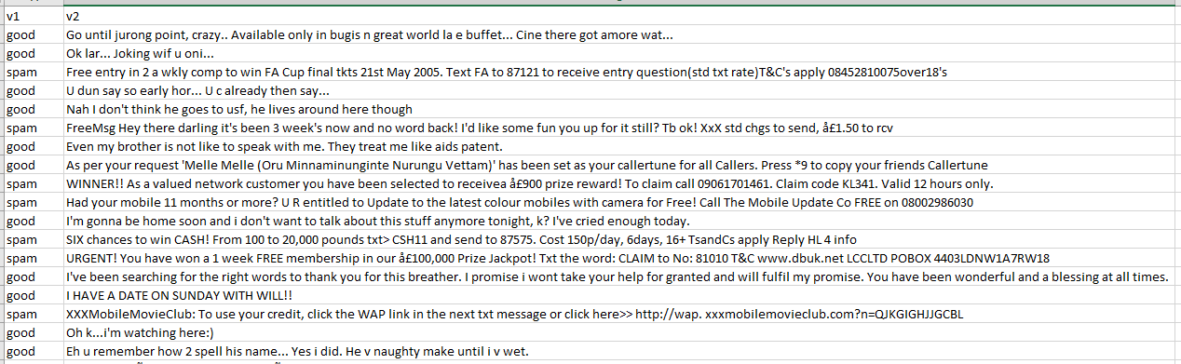
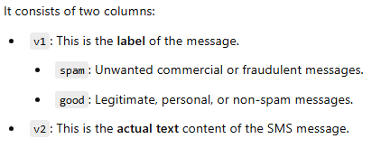
About Dataset:-
Aim:- You are given a spam dataset. Train the dataset using a suitable algorithm to correctly predict whether a new message is classified as spam or not.

Slide 3
By observing the structure of the dataset, we can see that each data point is labeled as either "spam" or "good." This indicates that the problem is a supervised learning task.
The aim is: "You are given a spam dataset. Train the dataset using a suitable algorithm to correctly predict whether a new data point is classified as spam or not."
Since the output variable is categorical (i.e., "spam" or "good"), we can conclude that this is a classification problem.
Now, let’s evaluate classification algorithms:
Support Vector Machine (SVM) works well for image data, but it's not ideal for raw text-based classification.
K-Nearest Neighbors (KNN) is based on distance calculations, which are less effective for high-dimensional, sparse text data.
Decision Trees are rule-based models, and here, it’s difficult to form clear-cut rules from unstructured SMS text data.
Naive Bayes works well when features are independent, but in this dataset, the words (features) seem to be correlated.
Logistic Regression is well-suited for cases where features are correlated and is commonly used for binary classification problems involving text data.

Slide 4
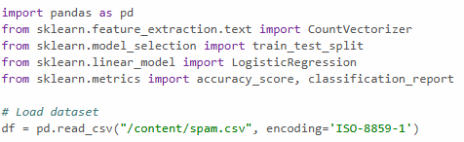
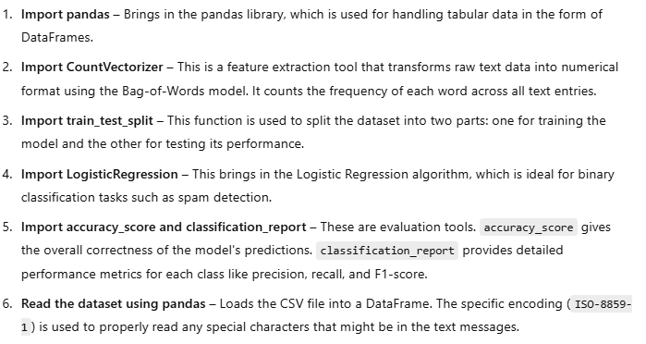

Slide 5
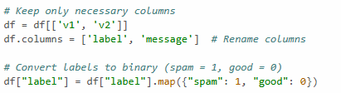
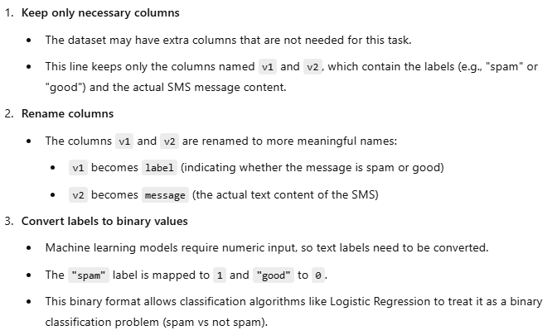

Slide 6

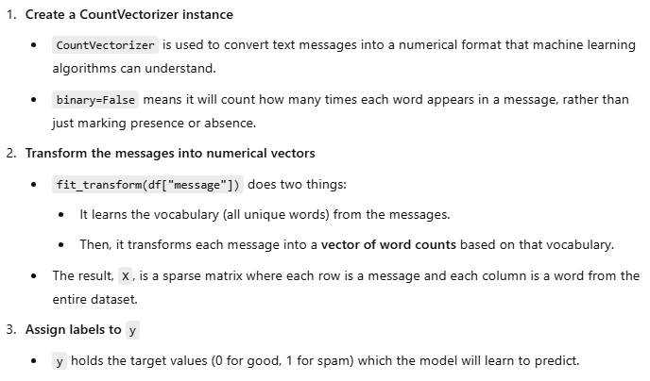

Slide 7
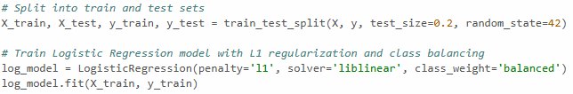
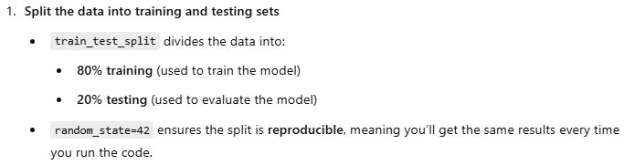
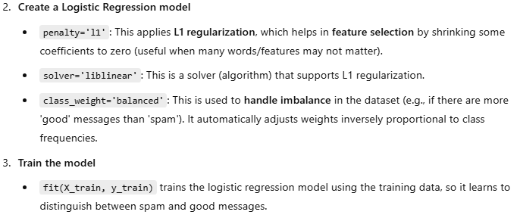

Slide 8
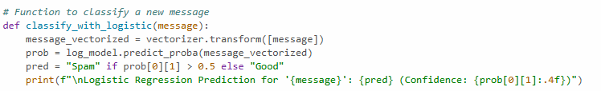
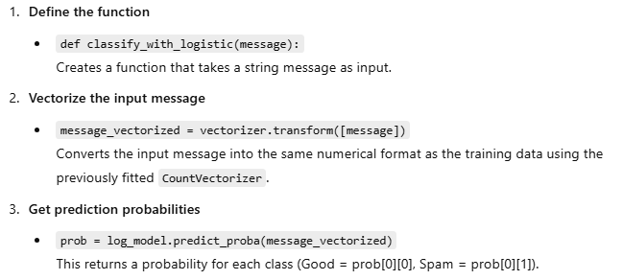
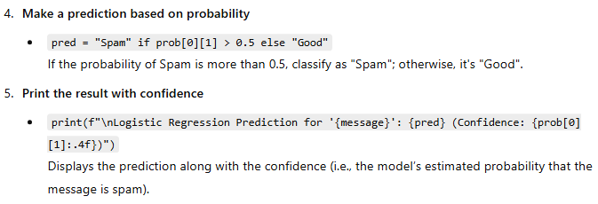

Slide 9
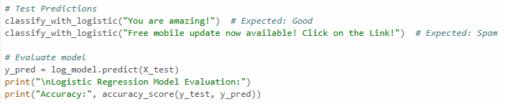
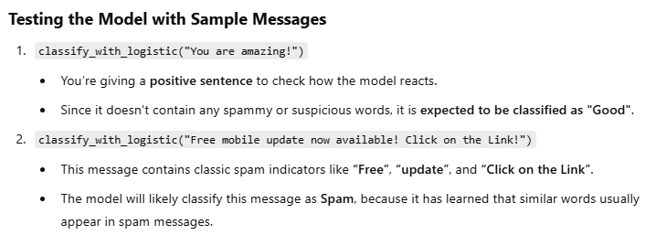
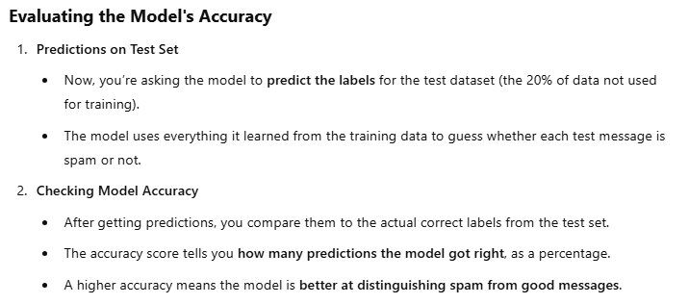

Slide 10
